Slide 1
Storytelling Case Study: Adidas Sales Performance In 2021-2022.
By
Halimat Salami

Slide 2
Business Understanding:
Adidas is a German athletic apparel and footwear corporation headquarted in Herzogenaurach, Bevaria, Germany.
It is the largest Sport wear manufacturer in Europe, and the second largest in the world.

Slide 3
Background:
Is there a seasonality component to Adidas sales?
What is the Retailer trends in our sales?
What Region account for the most sales?
What State account for sales in their Region?
What are the top selling products for Adidas?
What is the top sales method?

Slide 4
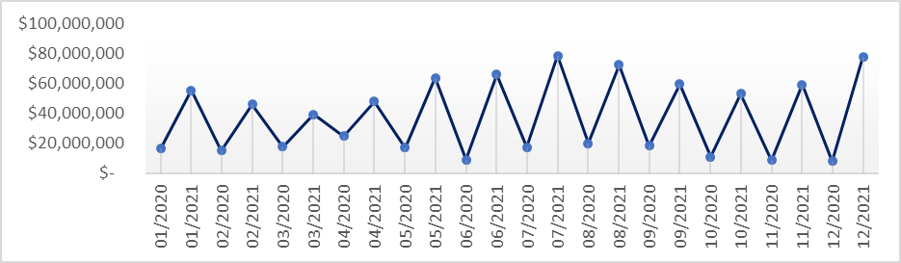
Sales Performance By Year
Total Sales made in 2021 performed so well when comparing to 2020.
In December 2021, the total sales made is almost 8 times of that in 2020.

Slide 5
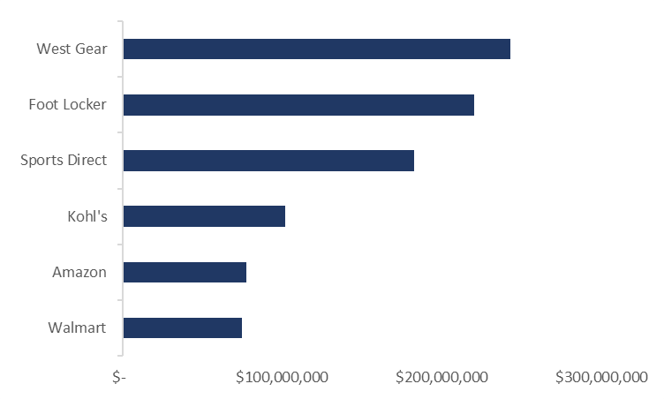
Retailer Sales By Company
West Gear generated the most sales.
Walmart and Amazon generated the least sales.
It is important to note, that the distrubtion of the data across both year is not the same across all retailers. Some companies had 2021 sales and not 2020 sales for some months. This would affect the distribution of sales for the companies.

Slide 6
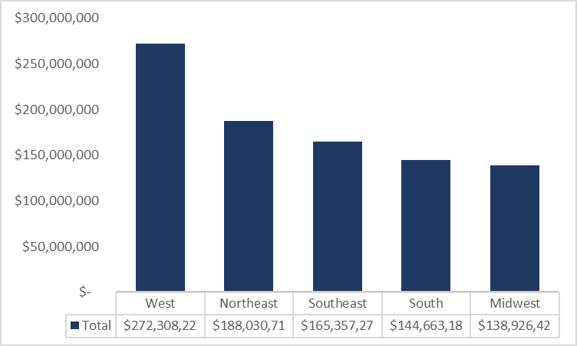
Sales By Region
West Region generated the highest sales of $272,308,22 for both year.
Next is Northest and Southeast with $188,030,71 and $165,35,27 respectively.
South and Midwest had the least Sales performance with $144,663,18 and $128,926,42 respectively.
We will take a further look at the performance as we move on.

Slide 7
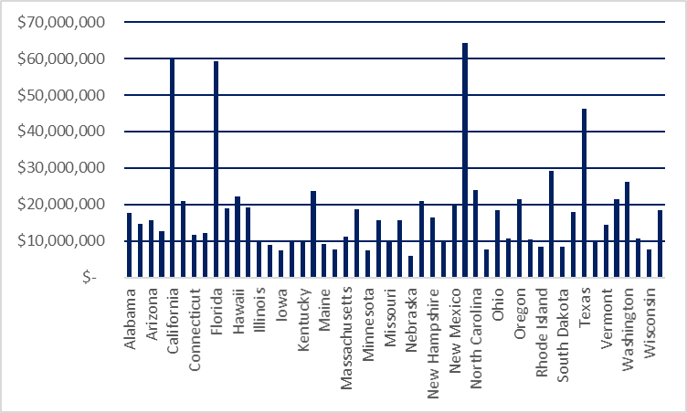
Sales In specific State By Region
West (California) Generated the most total sales in it Region
Northeast (New York) Generate the most total sales among other regions.
South Atlantic(Florida) Generate the most total sales in it Region.
West South Central (Texas) Generate the most total sales in it Region and generated the least Among other regions.

Slide 8
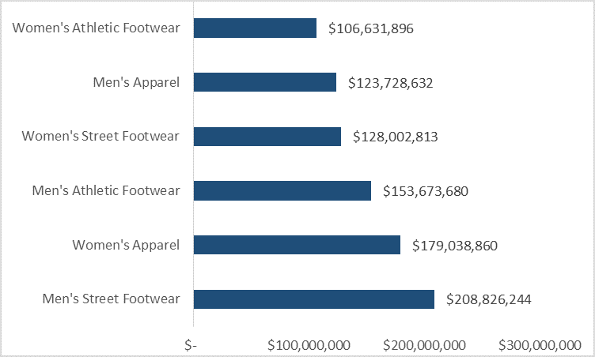
Total Sales By Product Type
Diving into product types we find mens Street Footwear with sales of $208,826,244, Women's Apparel with sales of $179,038,860, and Men's Athletic Footwear with sales of $153,673,680 are the top 3 categories.
Women's Athletic Footwear had the least sales of $106,631,896.

Slide 9
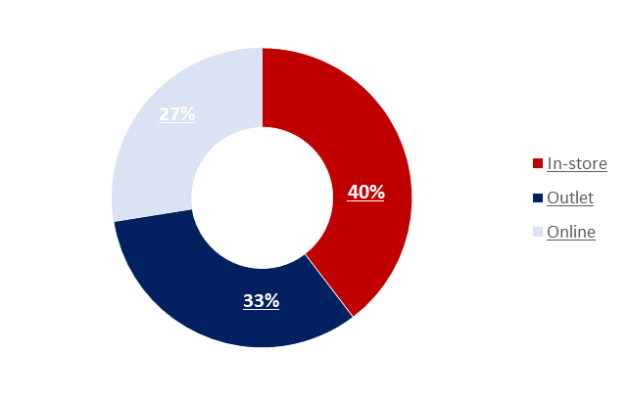
Total Sales in sales method
In-Store are the top earning sales method, with West Gate being a significant contributor and made it incredibly higher than other methods.
Online method are the least earning sales method among other Methods despite being run by big brands.

Slide 10
Observation
December 2021 made about 8 times the sales of Dec 2020. However, with a closer look at the Region below states the reasons:
Midwest Region did not take part in sales throughout 2020. However, they had sales throughout 2021. Northeast on the other hand had sales only in Jan 2020, And also throughout 2022.
South only took part in sales in Nov 2020, but was on sales throughout 2021.
Southeast operated only in April, Aug and Sept 2020 but was in operation all through 2021. However, Southeast performed well in sept and april 2020 more than the other months in 2021.
West is the only Region that operated all through 2020 and 2021 which is the overall best Sales performance among other Region. And with a closer look West region performed so well across both year.
From the State Ranking NYC top the Chart. However, West Gear and Foot locker are both in NYC.

Slide 11
Conclusion
Dec 2020 Sales performance was extremely low to Dec 2021 due to two Reasons:
Only West Region operated that month among other Region. While all Region was in operation in Dec 2021.
Also Only two Sales methods (Outlet, Online) was in operation in Dec 2020. While Outlet, Online and In-Store was in operation in Dec 2021.
The Least Sales Performance by Sales Method came from Amazon and Walmart despite being a big brand might be due to these reasons:
From the Sales Method ranking, Online came the least. However, Amazon and Walmart is an Online Store, while West Gear is an In-store whereby people can walk in, which means People might prefer a walk-into-reality rather than purchasing online.
The top selling products are Men's Street Footwear, Women's Apparel, and Men's Athletic Footwear, which together account for higher of sales.
In-store sales are the top earning sales method, with West Gate being a significant contributor to in-store sales volume.

